Slide 1
LiveShop.com
Team #1 Project Proposal

Slide 2
Contents
Background
01
Project Overview
02
Design Concept
03
Development
04
Expected Results
05

Slide 3
Background

Slide 4
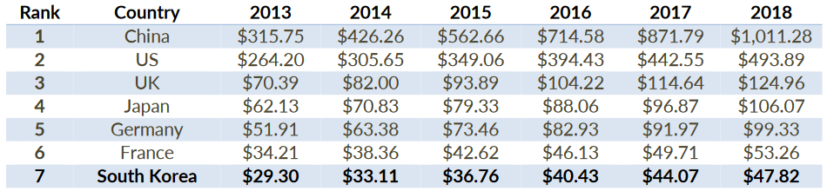
E-commerce in South Korea: trends and tendencies (1)
Top 7 countries ranked by retail e-commerce sales worldwide, in billion USD
Notes:
South Korean retail e-commerce Market is the 7th largest in the world and ranked the 3rd largest in the Asian-Pacific region. As in the table, the retail e-commerce market size is growing steadily each year. It shows roughly 10 percent of growth in recent years, and it is expected to be the same in the following years. (Nowak & Partner's Report)

Slide 5
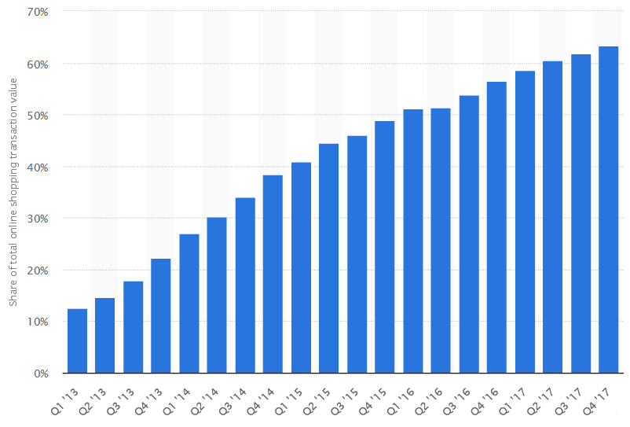
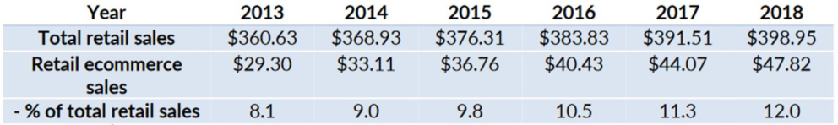
E-commerce in South Korea: trends and tendencies (2)
Share of mobile shopping transaction value against total online shopping transaction in South Korea from 1st quarter 2013 to last quarter 2017(*)
Total retail and retail e-commerce sales in South Korea, 2013-2018, in billion USD (From Nowak & Partner Co., Ltd.)
Since South Korea has one of the highest development index of Information and Communication Technology, the future of TV home shopping streaming as well as mobile shopping streaming are bright
(*) https://www.statista.com/statistics/381309/mobile-shopping-sales-share-korea-quarter/
Notes:
Yet the retail sales on e-commerce market is only 10% of the whole retail sales as presented in the table, it is steadily taken up the retail market.
Nowak & Partner is a management advisory firm in Seoul, which delivers customized turn-key solutions to international companies that are entering the Korean market hiring key personnel (headhunting) to lead the business in Korea, and negotiating critically in M&A or joint-venture agreements with Korean counterparts. We offer Project Management support across a wide range of areas, where commercial common sense, Korea expertise, and our reliability are winning factors.
Since South Korea has the highest development index of Information and Communication Technology, the future of the e-commerce is bright

Slide 6




Online shopping streaming?
Going shopping

Slide 7

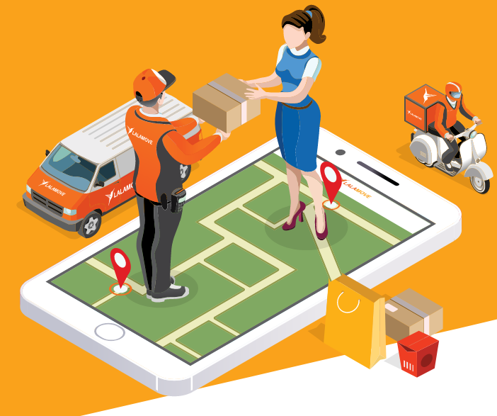


Online shopping streaming?
"Going shopping"
Desired delivery time
Notes:
sharing personal experiences of major guest speakers (who are experts in the field like fashion, household appliances, food and nutrition....) who have already tried out the products and interacting with customers through mobile platform have caught the eyes of the consumers.
24/7 broadcasting, good quality product at reasonable prices with some discounts in some golden time, holidays,…(customers can easily compare the price with other websites through online) and quick delivery to the customers

Slide 8


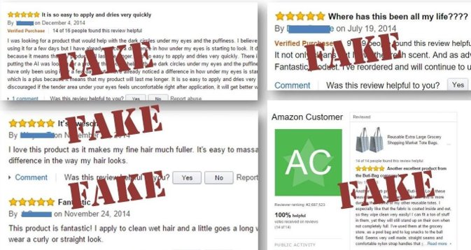

Online shopping streaming?
Fake Reviews/Rates
Overprices

Slide 9







Online shopping streaming?
Getting personal experiences of special guest speakers
Reasonable and discounted prices
Notes:
sharing personal experiences of major guest speakers (who are experts in the field like fashion, household appliances, food and nutrition....) who have already tried out the products and interacting with customers through mobile platform have caught the eyes of the consumers.
24/7 broadcasting, good quality product at reasonable prices with some discounts in some golden time, holidays,…(customers can easily compare the price with other websites through online) and quick delivery to the customers

Slide 10
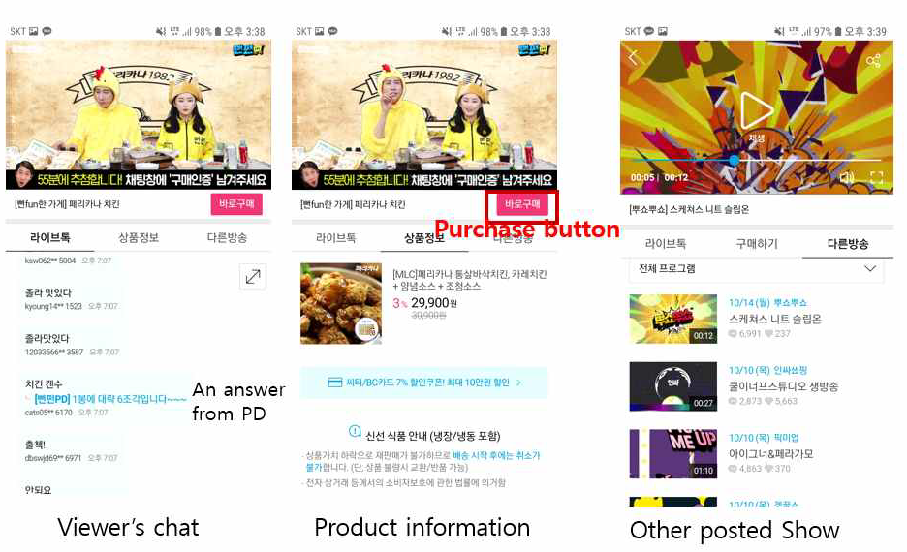

Case Study: CJMall

Slide 11
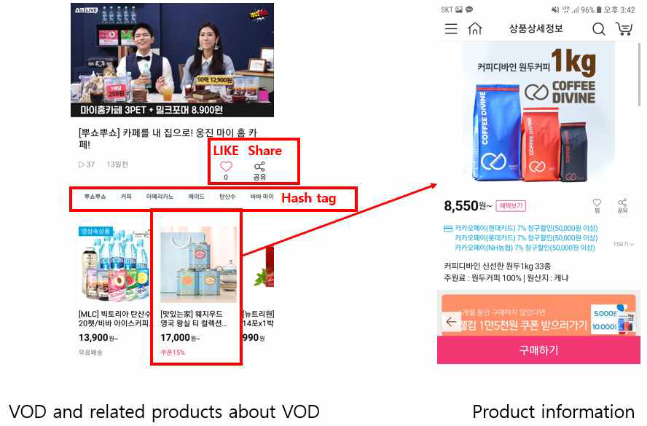
Case Study: CJMall

Slide 12














Case Study: CJMall
Downside: only CJ products are sold.
professional salespersons affiliated with CJ are the only ones who can broadcast their live streaming advertisements.

Slide 13
Project Overview

Slide 14
Main Points
live streaming
online chat
online purchasing system
Live Shop

Slide 15
Comparison with CJMall
Anyone can be a seller!
Suggestion system from recorded live streaming videos!
AI to increase effectiveness of software!
Evaluate seller’s behavior and analyze customer satisfaction
Keep track of time between purchase action and actual delivery
Detect fraud in sales or purchases
Analyze sales trend

Slide 16
Design Concept

Slide 17
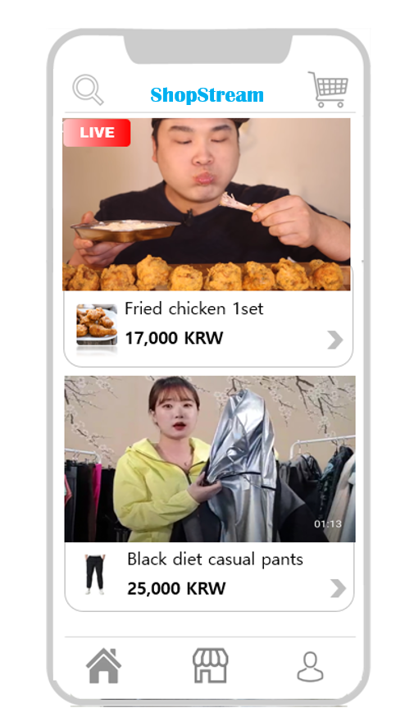
Main page
In main page, there are several Live streamings or recorded live streaming videos based on the user's preferences.
LiveShop
Live Streaming and related product
Recorded live streaming video(VOD)

Slide 18

Live Streaming
Viewers can follow the seller
By online chat, sellers can receive feedback from viewers.
Viewers can easily buy the product while watching Live Streaming

Slide 19
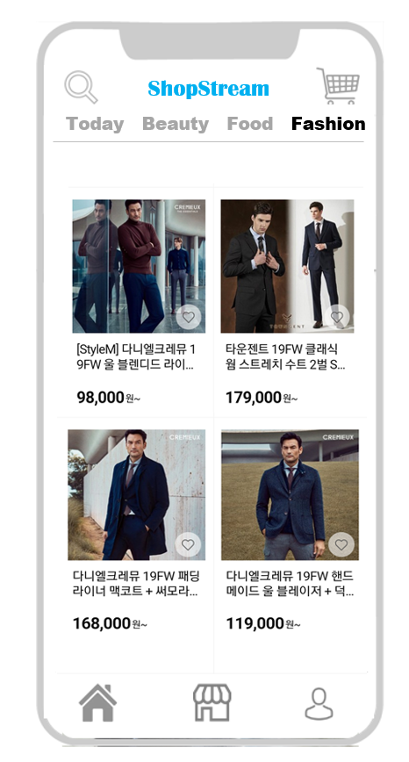
Store
In Store, there are several product registered by seller and introduced through Live Streaming
LiveShop
Product Categories

Slide 20
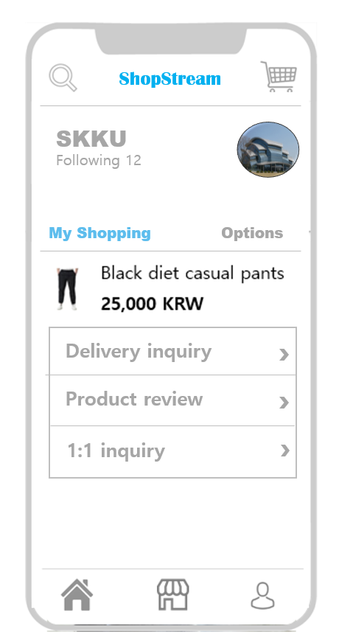
My Page
In My Page, users can check inforamtion about purchased products and set options related to the application
LiveShop

Slide 21
Development

Slide 22
Description
Components
Recording
Encoding & Packaging
Broadcast Live Stream from Mobile Device
Low Latency
Play Live Stream On Mobile Device
Distributes the live stream to user
Media Server
Receive & Transcodes live streams
Business Platform
Everywhere
Adaptive (Bitrate)
Devices compatibility
Interact comments
Product detail information
Safe Payment infrastructure
Chat System
Replay
Broadcast to other platform (Social Network, Youtube)
On-screen Chat

Slide 23
Model
User Interface
Stream
Recorder
Player
Chat
Business Core
Product Detail
Cart
Payment
Account Management
Chat System
AI Consultant
Security Core
Database

Slide 24




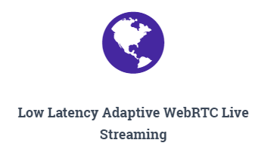
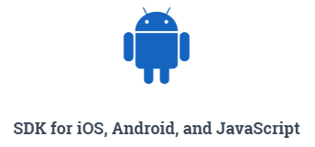


Technology
Media Server
Database
AI
Mobile App

Slide 25
Development Schedule
Exploratory Prototypes
Knowledge
Technology
Reuse-oriented
Waterfall
1st release
Incremental
Development
Delivery
Coping with change
Quality-oriented
Gain user
Additional features
Well development documents

Slide 26
Expected Results

Slide 27


Livestreaming
Sales and business growth for the sellers
Customers no longer jeopardized due to fake/misleading reviews since they can see the product being advertised live
Notes:
Increase in sales for the seller due to improved shopping experience facilitated by various features of LiveShop platform

Slide 28
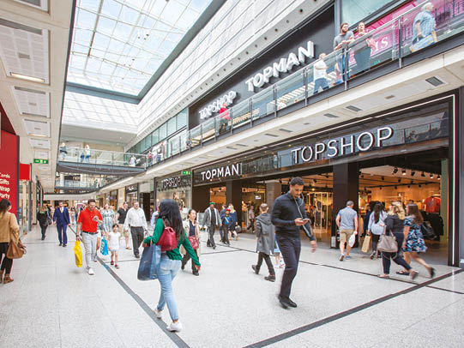
Available to various sellers
Provide customers with a wide range of shopping options for different or similar products
Notes:
Because the platform will allow multiple sellers to

Slide 29
Off-air content suggestion system
Convenience in terms of shopping since customers who missed live broadcast during the scheduled time will usually get recommendations for videos with some specific products
Notes:
There is a suggestion system from recorded live streaming videos.
After interally archiving the videos that were streamed live, the system can make basic recommendations.
In the buyer's point of view, depending on the choice of live streaming videos, the system can suggest additional products.
In the seller's point of view, it can view the video that corresponds to the highest selling product, so that the seller can benchmark on the style of advertising the video host performed.

Slide 30

AI-based platform enhancements
Improved shopping experience for customers
Customer satisfaction with the purchased products
Notes:
Artificial Intelligence is utilized to increase effectiveness of software.
We evaluate seller's behavior and analyze customer satisfaction to figure out trends in sales.
As part of customer satisfaction issues, it can keep track of time between purchase action and actual delivery,
so that it prevents delivery delays, and in extreme cases, sales fraud from advertisers.

